Slide 1
Magnetic Fields
An Introduction to Magnetism and its Applications

Slide 2
What is a Magnetic Field?
A magnetic field is a region around a magnetic material or a moving electric charge within which the force of magnetism acts.
Represented by field lines (imaginary lines used to visualize the magnetic influence).

Slide 3
Example of a Magnetic Field
Example: Magnetic field around a bar magnet
Description: When you place a bar magnet on a table and sprinkle iron filings around it, the filings align along invisible lines. These lines represent the magnetic field — they emerge from the north pole and curve around to enter the south pole.
Key Features:
Magnetic field lines are closer together near the poles, showing stronger magnetic force.
The lines form closed loops, continuing through the magnet from south to north inside.
This field can attract ferromagnetic materials like iron, nickel, and cobalt.
Visual Tip: Use an image showing iron filings around a bar magnet — looks like this:
N ——->——->——->——->——-> S
(Curved field lines around the magnet)

Slide 4
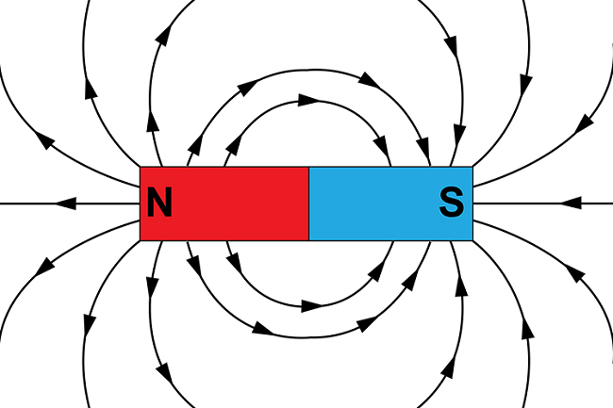

Slide 5
Sources of Magnetic Fields
Natural magnets (e.g., lodestone)
Electromagnets (current-carrying wires)
Earth’s magnetic field
Permanent magnets

Slide 6
Magnetic Field Lines
Show how field lines emerge from the north pole and enter the south pole.
Never cross each other.
Denser lines = stronger field.
Diagram suggestion: Use a bar magnet with iron filings pattern.

Slide 7
Magnetic Field Due to a Current-Carrying Wire
Right-hand rule to determine direction
Circular field lines around the wire
Field strength depends on current and distance from the wire

Slide 8
Magnetic Field in a Solenoid
Solenoid: a coil of wire
Creates a strong, uniform magnetic field inside
Acts like a bar magnet

Slide 9
Earth’s Magnetic Field
Earth behaves like a giant magnet
Magnetic poles vs. geographic poles
Used in navigation (compass)

Slide 10
Applications of Magnetic Fields
Electric motors
Magnetic levitation (Maglev trains)
MRI machines
Transformers and generators

Slide 11
Magnetic Field vs Electric Field
Feature | Magnetic Field | Electric Field
Source | Moving charges | Charges
Acts on | Moving charges | All charges
Field lines | Loops | Start/end on charges

Slide 12
Quiz Questions
1. What is the shape of magnetic field lines around a straight current-carrying wire? a) Straight lines b) Circular loops c) Zig-zag lines d) Parabolas
2. Which rule is used to determine the direction of magnetic field around a wire? a) Left-hand rule b) Fleming’s right-hand rule c) Ampere’s rule d) Right-hand thumb rule
3. What is a solenoid? a) A type of permanent magnet b) A loop of metal c) A coil of wire that acts like a magnet d) A magnetic field detector
4. What happens to the magnetic field strength if the current in a wire increases? a) It decreases b) It stays the same c) It increases d) It disappears
5. What is the SI unit of magnetic field strength? a) Tesla b) Newton c) Ampere d) Ohm

Slide 13
Quiz Questions
6. In which direction do magnetic field lines travel? a) From south to north b) In circles c) From north to south outside the magnet d) From north to south inside the magnet
7. What device is used to detect magnetic fields? a) Voltmeter b) Galvanometer c) Barometer d) Thermometer
8. Magnetic field lines never: a) Start at the south pole b) Cross each other c) Form closed loops d) Exit the north pole
9. What kind of field is created by a moving electric charge? a) Gravitational field b) Magnetic field c) Thermal field d) None of the above
10. Which of the following is not a use of magnetic fields? a) MRI scanning b) Cooking in a microwave c) Magnetic levitation d) Electric motor

Slide 14
Quiz Answer Key
b) Circular loops
d) Right-hand thumb rule
c) A coil of wire that acts like a magnet
c) It increases
a) Tesla
c) From north to south (outside the magnet)
b) Galvanometer
b) Cross each other
b) Magnetic field
b) Cooking in a microwave

Slide 15


